Slide 1

Exception Handling With C#
Objectives
Definition of "Exception".
Exception class Hierarchy.
Try/Catch Block.
State the purpose of a "finally" block.
Creating Custom Exceptions and Throw an Exception.

Slide 2
What is an Exception An Exception is an abnormal event or error condition that exists in the technical execution of a particular statement that occurs during program execution. Exceptions can occur in the code you write (internal) or external code (DLL) that your program calls.
Some examples of error conditions include the following:
File I/O related problems
Network communication problems
Element access that is beyond the bound of an array
Running out of memory during program execution
Issue when doing a Divide-by-zero operation

Slide 3
Exception class Hierarchy
Exception Class Hierarchy
Exception
System exception
Application exception
Runtime exception

Slide 4
Using Try/Catch Blocks To catch and handle exceptions, you need to place exception-throwing code in a try code and catch the resulting exception when it is thrown
try { ... } catch (Exception err) // Exception handling { Console.WriteLine(err.Message); }

Slide 5
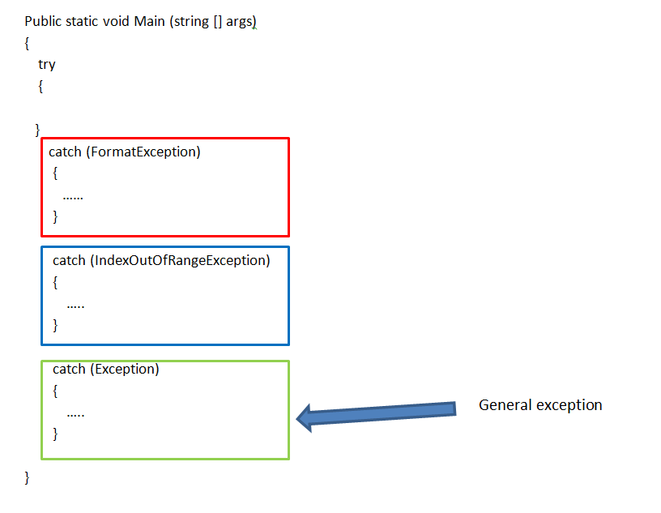
The catch blocks can be one or more , where error handling code is placed to properly deal and recover from the exception.

Slide 6
purpose of a "finally" block :-
An exception can leave your program in an inconsistent state by not releasing resources
Whatever happens inside the try block, it is guaranteed that finally block gets executed. Hence, all resource releases should be in the finally block.
try
{
}
catch
{
}
Finally
{
}
Will execute all time

Slide 7
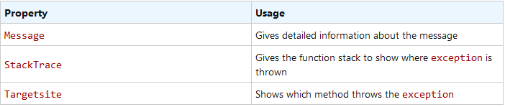
What is Exception Class?
This class is provided by .NET Framework to handle any exception that occurred. The Exception class is the base class for all other Exception class provided by .NET Framework.
The exception object has some important properties. Some of them are given below:

Slide 8
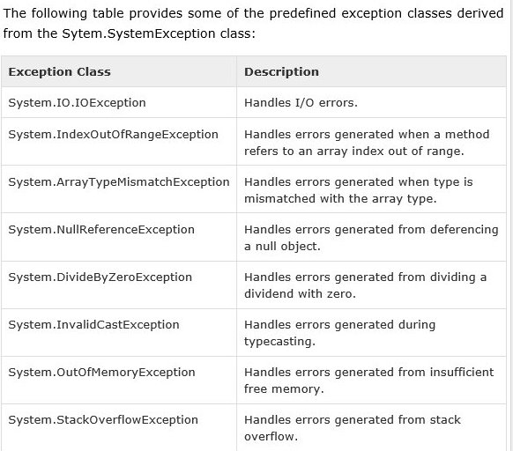

Slide 9
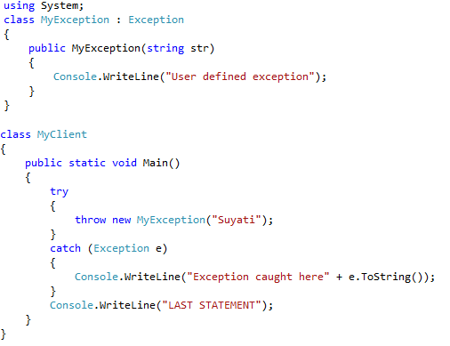
User-defined Exceptions
In C#, it is possible to create our own exception class. But Exception must be the ultimate base class for all exceptions in C#. So the user-defined exception classes must inherit from Exception class or one of its standard derived classes.

Slide 10
Q&A

